Slide 1
Data Analytics based
Key Insights on
Bluebikes (Boston, USA)
and
Divvy Bikes (Chicago, USA)
Sridevi Muralidharan
Data Analytics Immersive
General Assembly
Project 2 Week 3 05 Feb 2021
Many thanks to my GA Instruction Team

Slide 2
How many trips were there in each month of each year?
Points
Jun - Oct increased activity - coincides with the summer weather in Boston - so that is good to see
Doubled riders than the previous two years

Slide 3
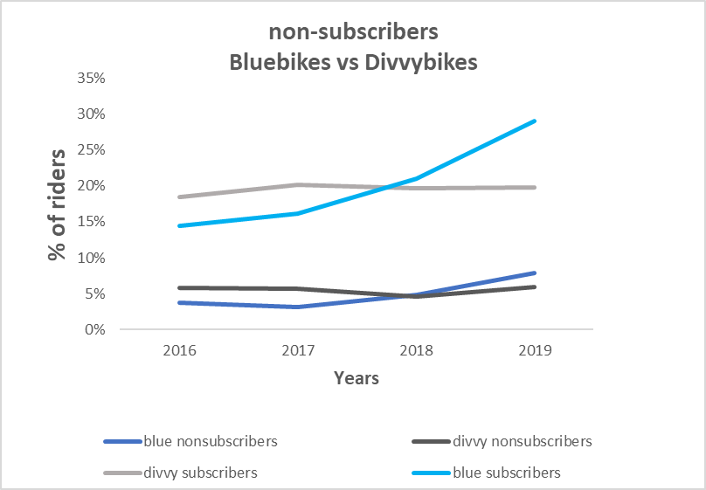
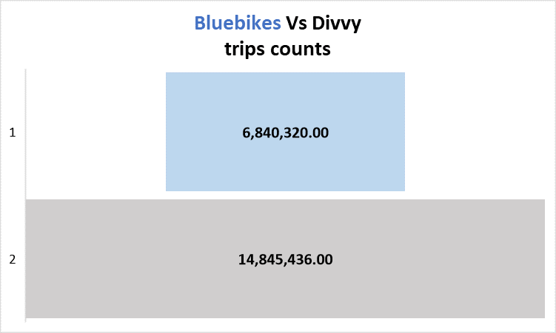
Which organisations are showing the most growth in bike rentals?
Points
Bluebikes subscribers have been steadily growing past 4 years
Bluebikes 50% low on the number of rides it gets compared to Divvy bikes
If they find a way to tap the non-subscribers it will definitely improve longterm growth and revenue for the company

Slide 4
Is there a difference in growth between holiday activity and commuting activity?
What are the trends comparing bluebikes and divvy

Slide 5
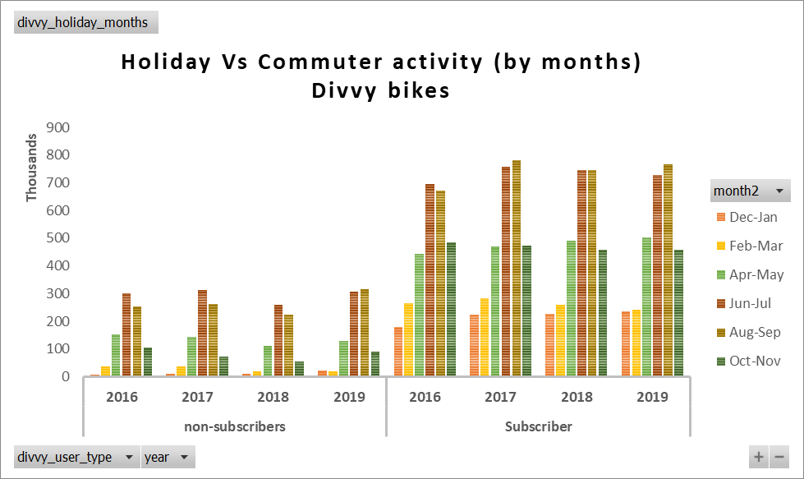
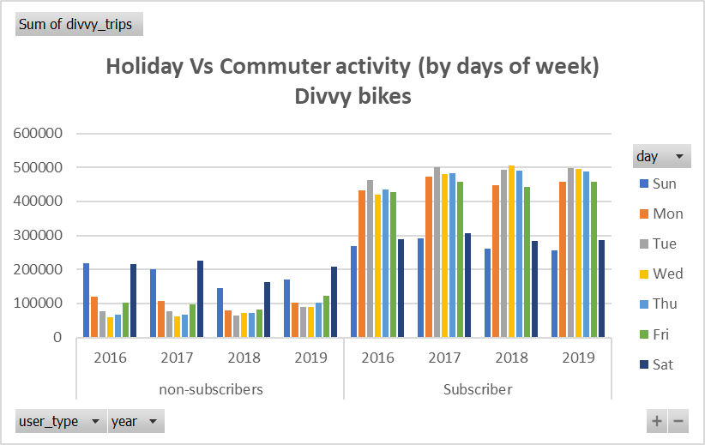

Slide 6
Points
For both BLUEBIKES and Divvy bikes
When we look in terms of months, during Dec and Jan, activity is low across all years.
and this period corresponds to holiday period globally and
so yes it is negatively affecting bluebikes in terms of company growth and revenue
Whereas when we look at holiday period - Saturday and Sunday
less number of rides across all years
means people prefer to ride bikes for commuting mon-fri than weekends
interestingly most subscribers follow this pattern and the casual users appear to indulge in weekends

Slide 7
What was the longest journey? What do we know about it?
Bluebikes Longest journey
-- a ride from Glendale Square (Ferry St at Broadway) to Belgrade Ave at Walworth St . Ride distance
-- calculated to be 10 k.
--it happened in mid-august 2019 amd by a man likely to be 51 years of age

Slide 8
What was the furthest relocation?
-- 9.09 k move,
-- bike was relocated from station at Packard Ave at Powderhouse Blvd in Sommervile to station at Blue Hill Ave at Almont St in Boston
How far is a typical journey?
--A typical journey irrespective of gender for bluebike riders - 1.15 k distance
--comparing ride data from 2016 and 2019

